Slide 1
Where Vintage and Modern Collide®

Slide 2
Proudly Made in America on Florida’s Space Coast
Notes:
Barn Light Electric products are proudly made in the USA and handcrafted to your specification! We are located on Florida’s Space Coast, in a town called Titusville. Barn Light is proud, to be a strong supporter of the community where our owners, Bryan and Donna Scott, call home.

Slide 6
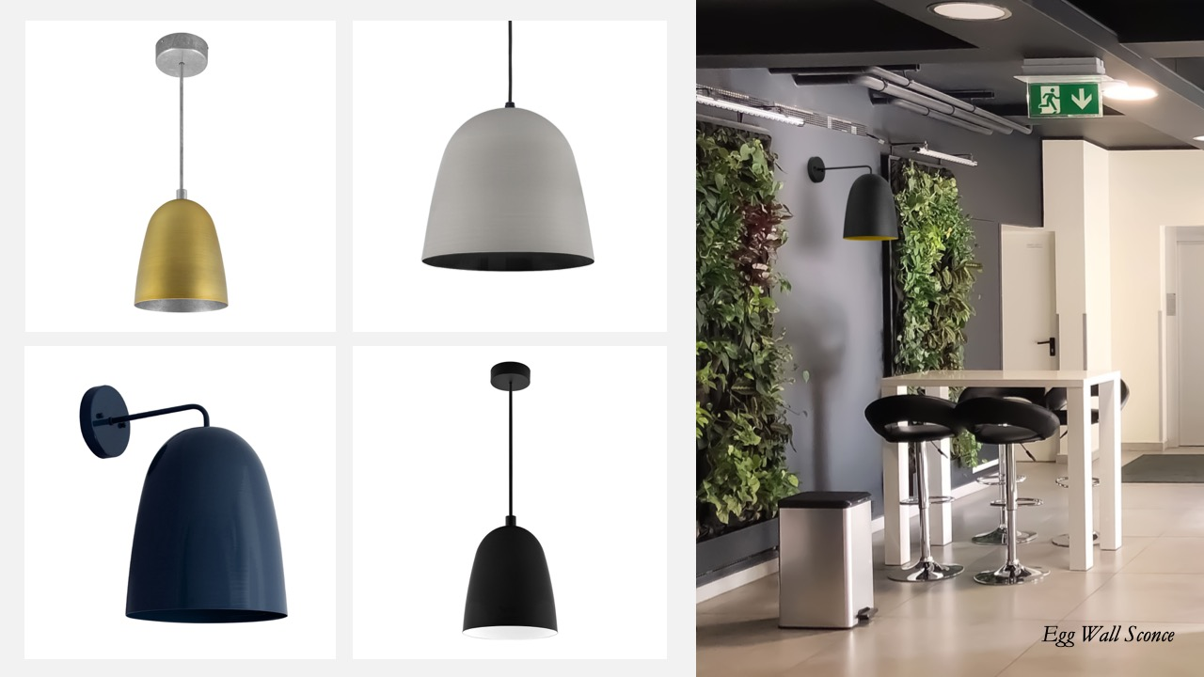

Slide 10
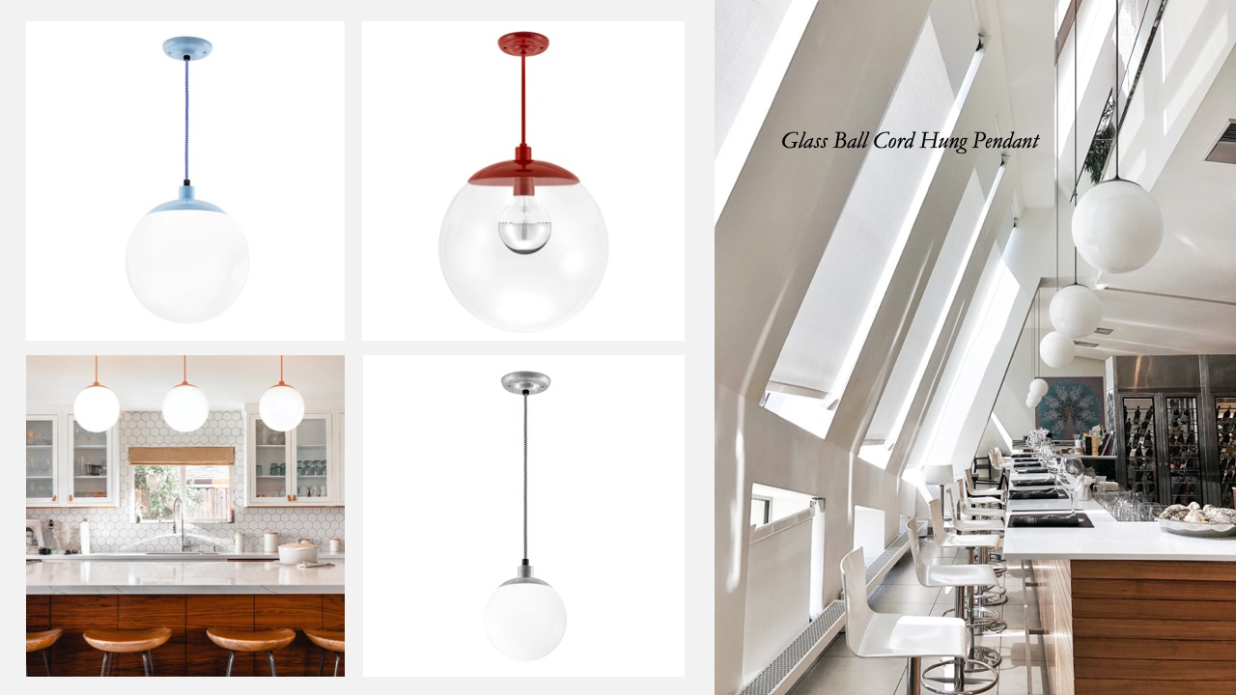

Slide 12
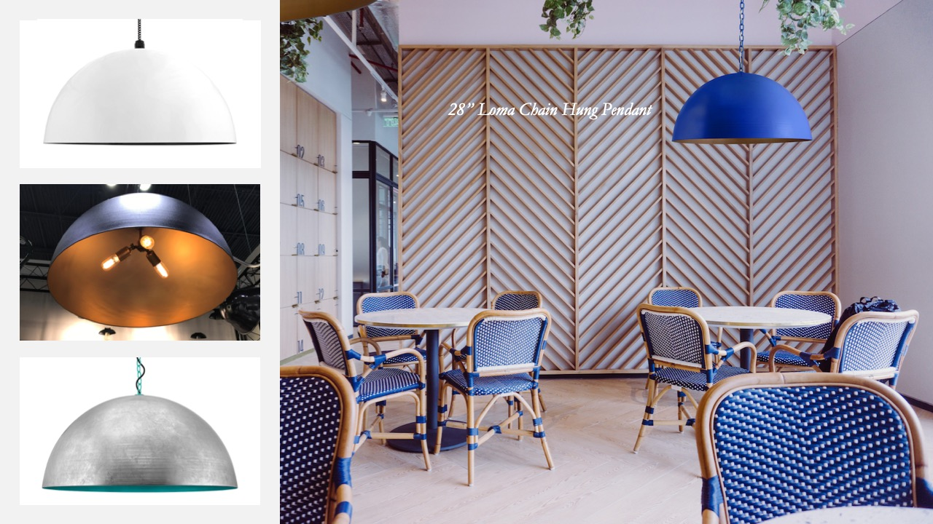

Slide 15
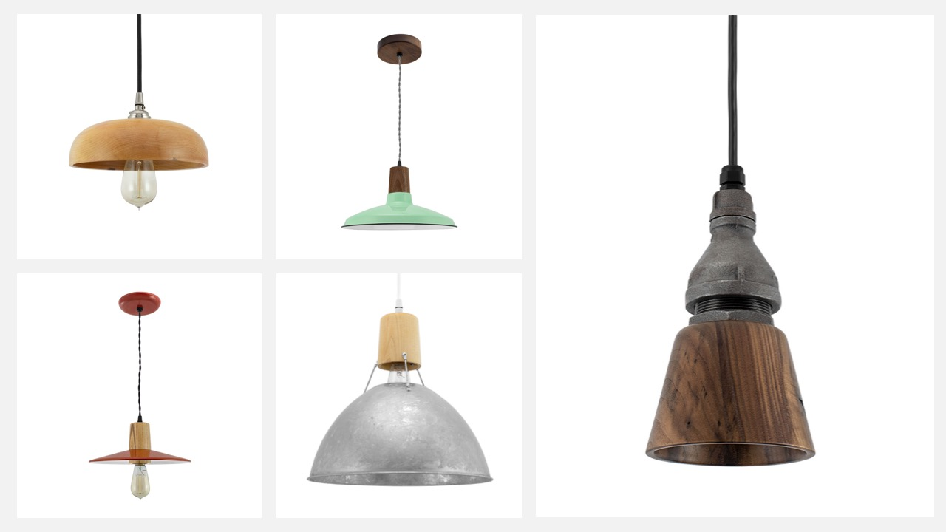

Slide 16
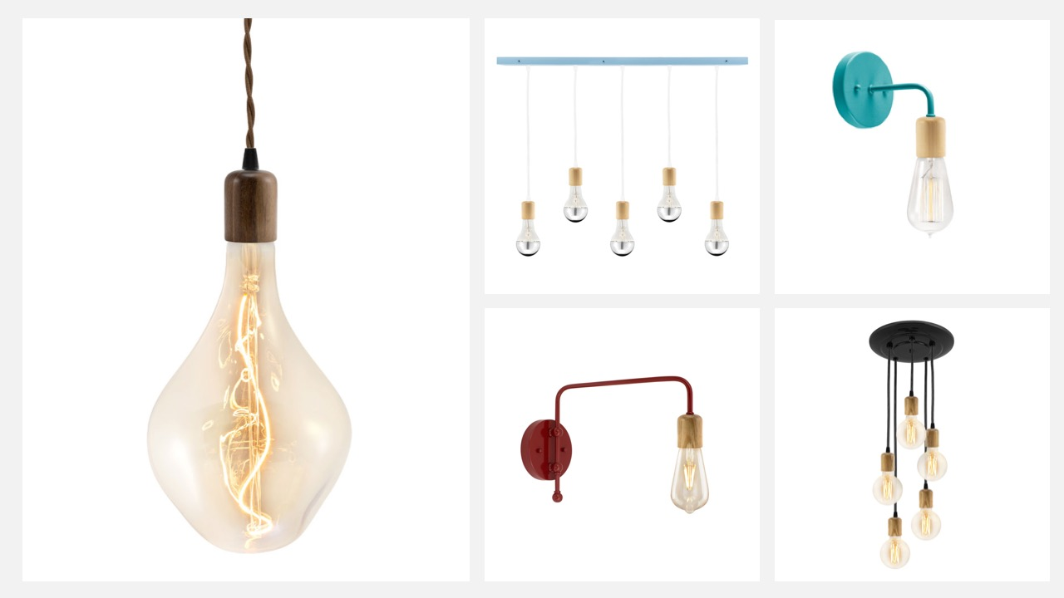

Slide 17
Notes:
Will this be LED

Slide 18
Notes:
Will this be LED

Slide 23
